Slide 1
Simultaneous Localization and Mapping
*Original presentation by Benzun Wisely Babu presented in fall 2016

Slide 2
Overview
Basic probability
The problem of SLAM
Bayes Filter based SLAM
Feature extraction
Matching
Frontend – Visual Odometry
Backend
GraphSLAM
Reference Materials

Slide 3

Basic probability!
Bayes theorem
$P\left(A|B\right)=\frac{P(B|A)P(A)}{P(B)}$
$P\left(A|B,C\right)=\frac{P(B|A,C)P(A|C)}{P(B|C)}$
Normalization
$P\left(A|B\right)=η P\left(B | A\right) P(A)$
$η=P{\left(B\right)}^{−1}=\frac{1}{\sum_{A}{P(B|A)P\left(A\right)}}$

Slide 4
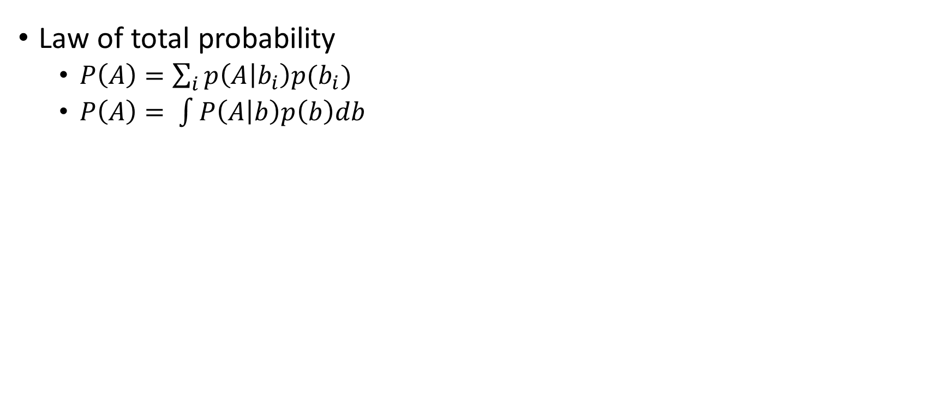
Basic probability!
Law of total probability
$P\left(A\right)=\sum_{i}{p\left(A | b_{i}\right)p(b_{i})}$
$P\left(A\right)= \int{P\left(A | b\right)p\left(b\right)db}$

Slide 5
Basic probability!
0 | 0.5 | 0 | 0.5 | 0
Law of total probability
$P\left(A\right)=\sum_{i}{p\left(A | b_{i}\right)p(b_{i})}$
$P\left(A\right)= \int{P\left(A | b\right)p\left(b\right)db}$
U = 2
Motion model
Exact = 0.8
Undershoot = 0.1
Overshoot = 0.1
0 | 0.5 | 0 | 0.5 | 0
0.4 + 0 | 0.05 + 0 | 0.05 + 0 | 0.4 + 0 | 0.05 + 0.05

Slide 6
Localization
Where am **I** in the world?
Robot observations and robot belief about location
Assume map of world is perfectly known!

Slide 7
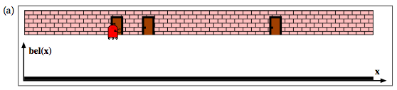
Localization
x = state

Slide 8
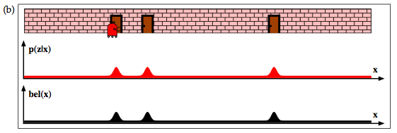
Localization
z = observation
x = state

Slide 9
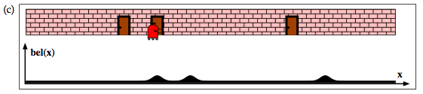
Localization
z = observation
x = state

Slide 10
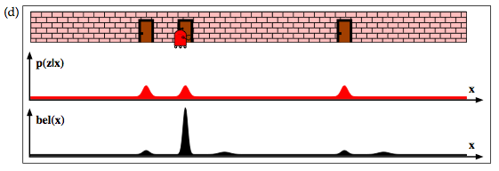
Localization
z = observation
x = state

Slide 11
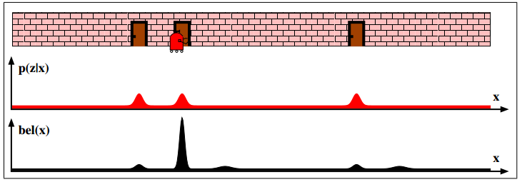

Localization
Where am I in the world $(position= x)$?
Robot observations [$p(z|x)$] and robot belief about location [$bel(x)$]
Assume map of world is perfectly known!
Example:

Slide 12
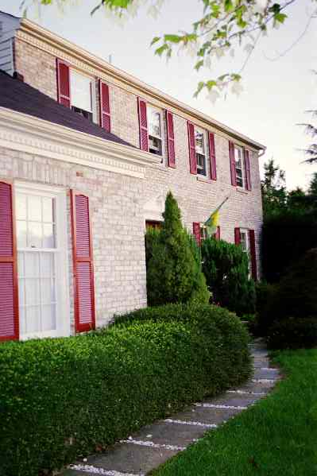
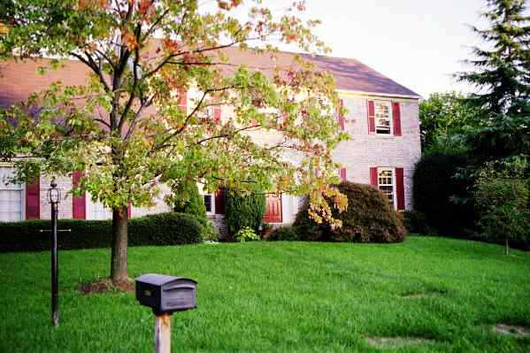
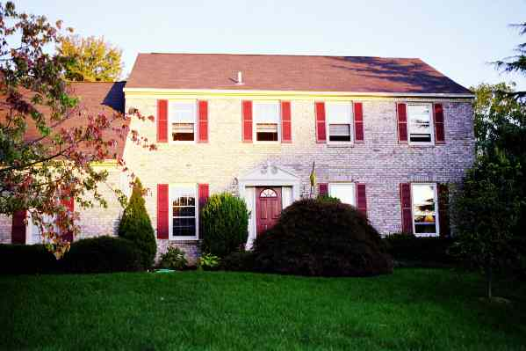
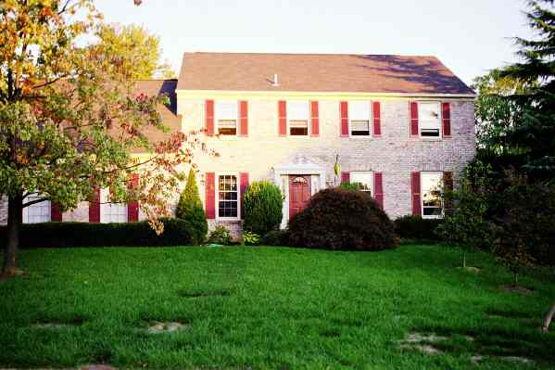
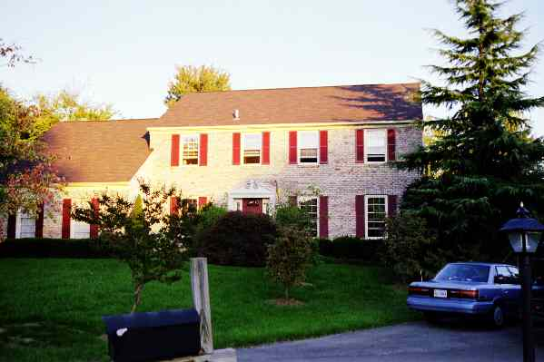

Mapping
What does the world look like?
Image observations to generate the 3D geometry of the world
Assume robot’s position [$x]$ is perfectly known!
Example:

Slide 13







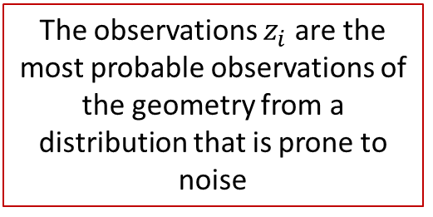
Mapping
The observations $z_{i}$ are the most probable observations of the geometry from a distribution that is prone to noise
What does the world look like? ($map = m$)
Image observations[$p(z|m,x)$] to generate the 3D geometry of the world [$bel\left(m\right)$]
Example:
$$bel(m)$$
$$p(z_{1}|m,x_{1})$$
$$p(z_{n}|m,x_{5})$$
$$p(z_{2}|m,x_{2})$$
$$p(z_{3}|m,x_{3})$$
$$p(z_{..}|m,x_{4})$$

Slide 14
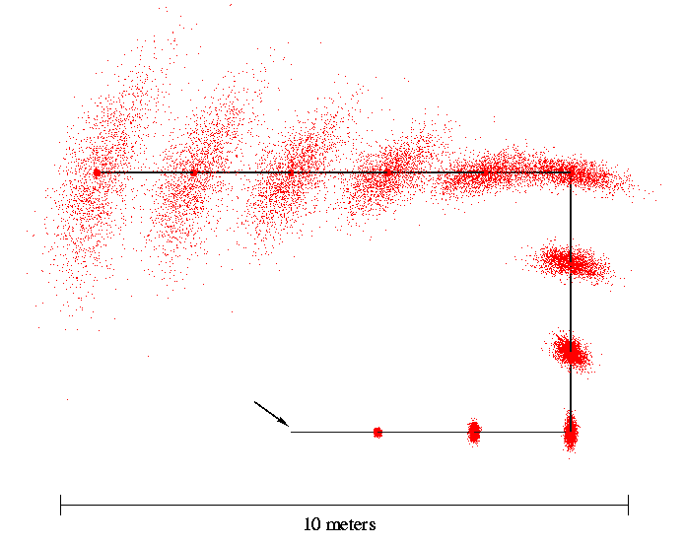
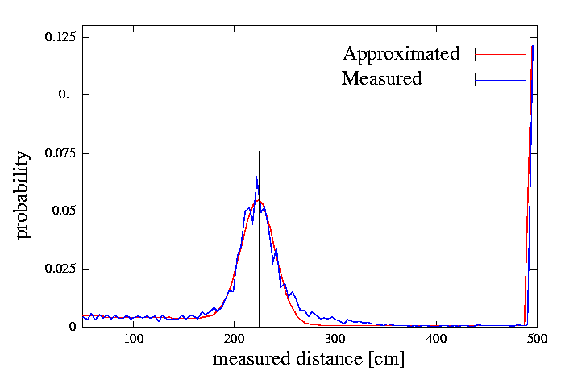
Uncertainty in Measurements and Motion
Odometry
Laser Sensor

Slide 15
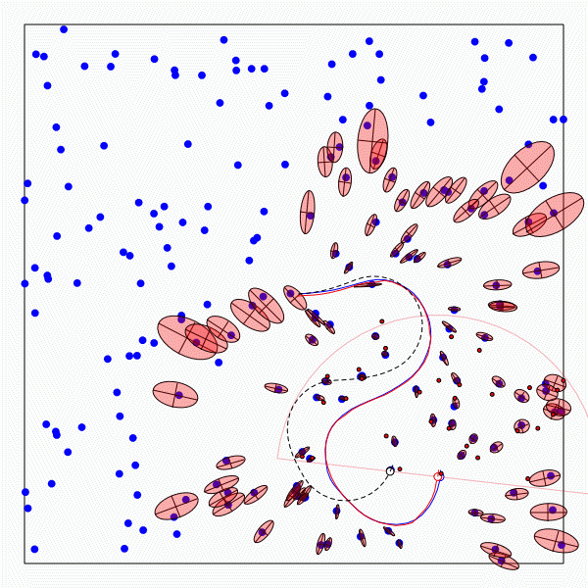
Simultaneously localization and Mapping
Location unkown!! Map unknown!!
Error in location estimate is based on accuracy of map
Error in map estimate is based on accuracy of location
Early 1980s….. We found the answer…
Solve for both the map and the location simultaneously as a joint estimation problem

Slide 16
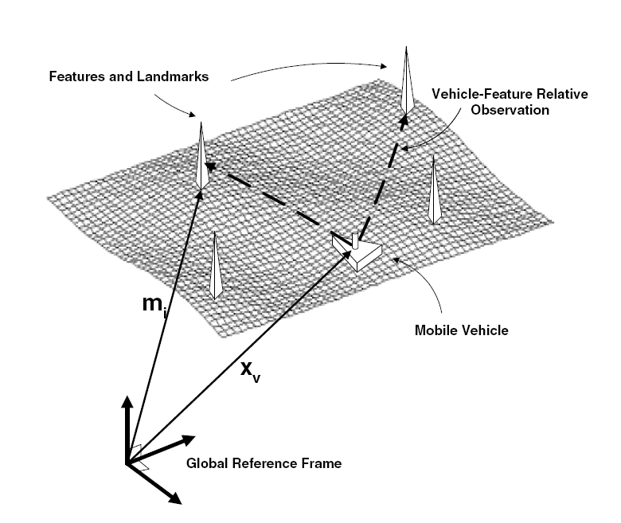
Simultaneous Localization and Mapping (SLAM)
Solve for both the map and the location simultaneously as a joint estimation problem
Input:
Observation of landmark
Robot control inputs
Starting point
Output:
Map of the world
Robot position in the world

Slide 17
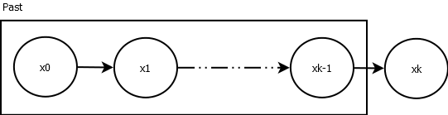
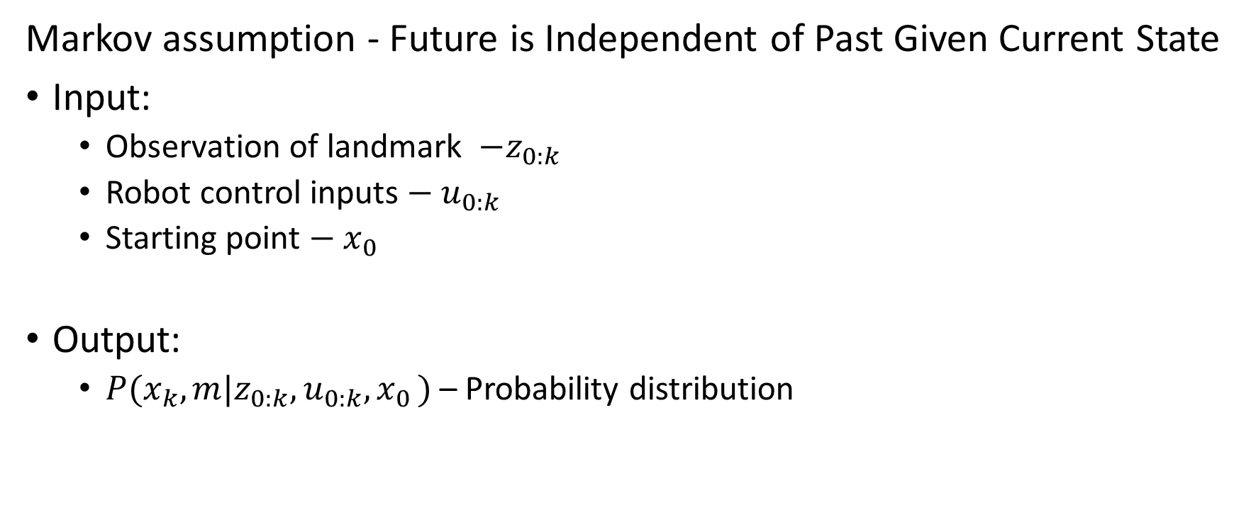
Bayes filter formulation of SLAM
Markov assumption - Future is Independent of Past Given Current State
Input:
Observation of landmark ${ −z}_{0:k}$
Robot control inputs$−{ u}_{0:k}$
Starting point $−{ x}_{0}$
Output:
$P(x_{k},m|z_{0:k},u_{0:k},x_{0 })$ – Probability distribution

Slide 18

Bayesian formulation of SLAM (Filtering)
To solve for SLAM we need to model
Robot motion model - $P\left(x_{k} | x_{k−1}, u_{k}\right)$
Robot observations model - $P\left(z_{k} | x_{k}, m\right)$
Incremental solution!

Slide 19
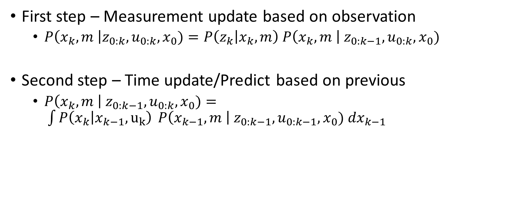
Bayesian formulation of SLAM (Filtering)
First step – Measurement update based on observation
$P\left(x_{k}, m \right|z_{0:k}, u_{0:k}, x_{0})=P\left(z_{k} | x_{k},m\right) P\left(x_{k},m \right| z_{0:k−1}, u_{0:k}, x_{0})$
Second step – Time update/Predict based on previous
$P\left(x_{k}, m \right| z_{0:k−1}, u_{0:k}, x_{0})= \int{P\left(x_{k} | x_{k−1}, u_{k}\right) }P\left(x_{k−1}, m \right| z_{0:k−1}, u_{0:k−1}, x_{0}) dx_{k−1}$

Slide 20

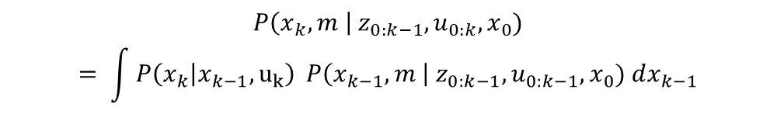
Bayesian formulation of SLAM (Filtering)
$$P\left(x_{k}, m \right| z_{0:k−1}, u_{0:k}, x_{0})$$
$$= \int{P\left(x_{k} | x_{k−1}, u_{k}\right) }P\left(x_{k−1}, m \right| z_{0:k−1}, u_{0:k−1}, x_{0}) dx_{k−1}$$
Lose information
(Convolution)
Gain information
Sense
Move
$$P\left(x_{k}, m \right|z_{0:k}, u_{0:k}, x_{0})$$
$$=P\left(z_{k} | x_{k},m\right) P\left(x_{k},m \right| z_{0:k−1}, u_{0:k}, x_{0})$$
$$x_{0}$$
Initial Belief

Slide 21
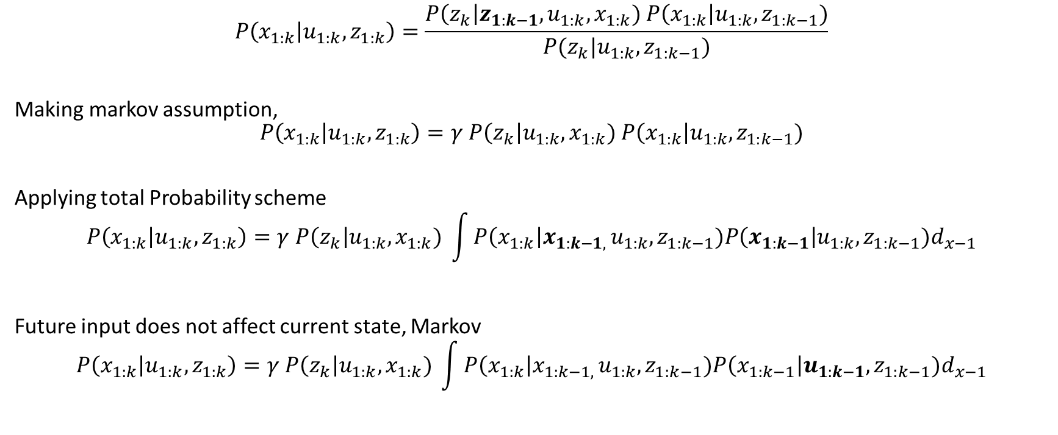
Bayesian formulation of SLAM (Filtering)
$$P\left(x_{1:k} | u_{1:k},z_{1:k}\right)=\frac{P\left(z_{k}\right|z_{1:k−1}, u_{1:k}, x_{1:k}) P\left(x_{1:k}\right|u_{1:k},z_{1:k−1})}{P(z_{k}|u_{1:k}, z_{1:k−1})}$$
Making markov assumption,
$$P\left(x_{1:k} | u_{1:k},z_{1:k}\right)=γ P\left(z_{k}\right|u_{1:k}, x_{1:k}) P\left(x_{1:k}\right|u_{1:k},z_{1:k−1})$$
Applying total Probability scheme
$$P\left(x_{1:k} | u_{1:k},z_{1:k}\right)=γ P\left(z_{k}\right|u_{1:k}, x_{1:k}) \int{P\left(x_{1:k}\right|{x_{1:k−1, }u}_{1:k},z_{1:k−1})P\left(x_{1:k−1}\right|u_{1:k},z_{1:k−1})d_{x−1}}$$
Future input does not affect current state, Markov
$$P\left(x_{1:k} | u_{1:k},z_{1:k}\right)=γ P\left(z_{k}\right|u_{1:k}, x_{1:k}) \int{P\left(x_{1:k}\right|{x_{1:k−1, }u}_{1:k},z_{1:k−1})P\left(x_{1:k−1}\right|u_{1:k−1},z_{1:k−1})d_{x−1}}$$

Slide 22
Bayes Filters
z = observation
u = action
x = state
Bayes
Markov
Total prob.
Markov
Markov

Slide 23

MAP formulation of SLAM (Optimization)
Input:
Observation of landmark ${ −z}_{0:k}$
Robot control inputs$−{ u}_{0:k}$
Starting point $−{ x}_{0}$
Output:
Mode of pose – $\hat{x_{k}}$
Mode of map – $\hat{m_{k}}$

Slide 24
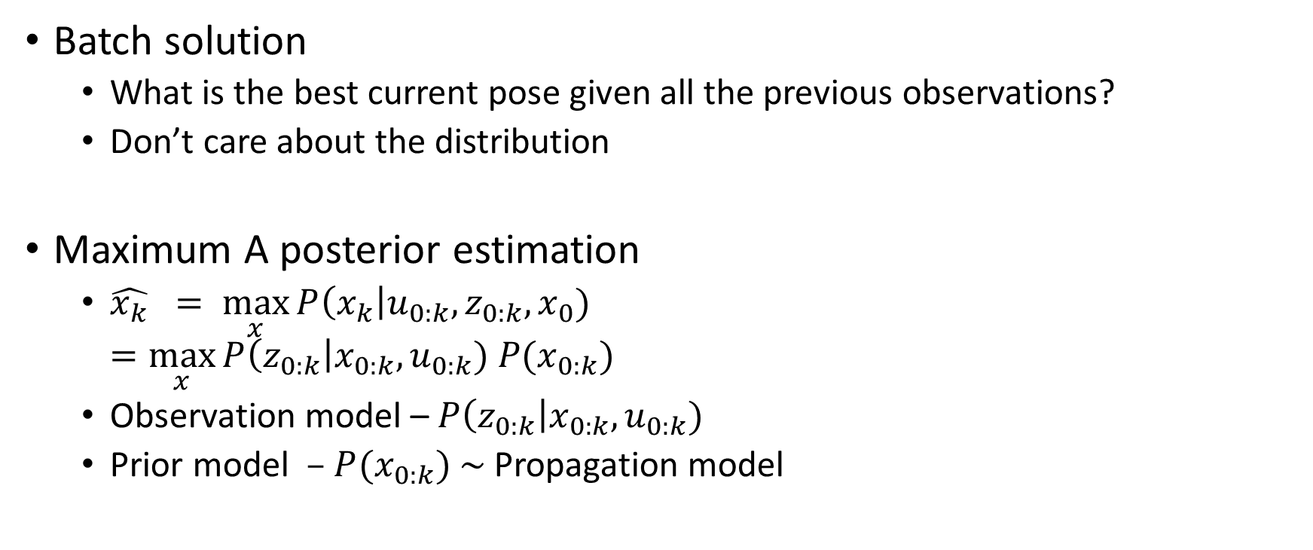
MAP formulation of SLAM (Optimization)
Batch solution
What is the best current pose given all the previous observations?
Don’t care about the distribution
Maximum A posterior estimation
$\hat{x_{k}} = \max_{x}{P\left(x_{k}\right|u_{0:k}, z_{0:k}, x_{0}) }$ $=\max_{x}{P\left(z_{0:k}\right|x_{0:k}, u_{0:k}) P(x_{0:k})}$
Observation model – $P\left(z_{0:k}\right|x_{0:k}, u_{0:k})$
Prior model – $P(x_{0:k})$ ~ Propagation model

Slide 25
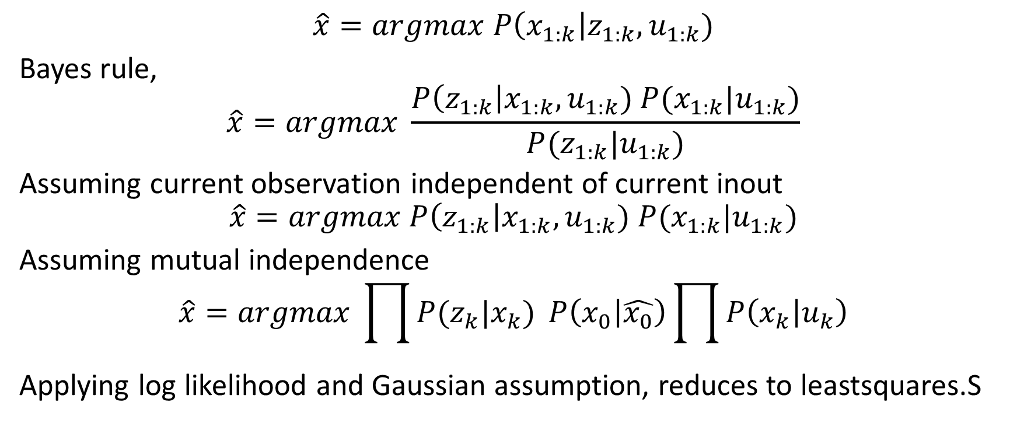
MAP formulation of SLAM (Optimization)
$$\hat{x}=argmax P\left(x_{1:k}\right|z_{1:k}, u_{1:k})$$
Bayes rule,
$$\hat{x}=argmax \frac{P\left(z_{1:k}\right|x_{1:k}, u_{1:k}) P(x_{1:k}|u_{1:k})}{P(z_{1:k}|u_{1:k})}$$
Assuming current observation independent of current inout
$$\hat{x}=argmax P\left(z_{1:k}\right|x_{1:k}, u_{1:k}) P(x_{1:k}|u_{1:k})$$
Assuming mutual independence
$$\hat{x}=argmax \prod{P(z_{k}|x_{k})} P\left(x_{0} | \hat{x_{0}}\right)\prod{P\left(x_{k} | u_{k}\right)}$$
Applying log likelihood and Gaussian assumption, reduces to leastsquares.S

Slide 26
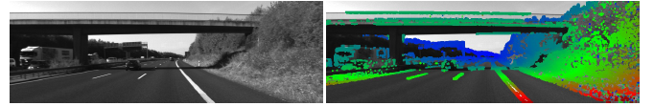
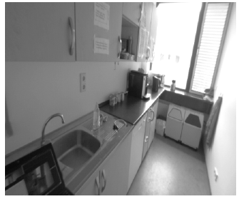
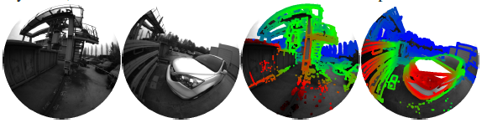
Visual SLAM
SLAM with camera as sensor
Stereo camera pairs
Mono camera
Omnidirectional cameras
Sparse Visual SLAM
Use certain information
Dense Visual SLAM
Use all information
Semantic Visual SLAM
Use object information

Slide 27
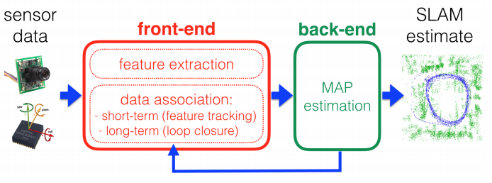
Visual SLAM architecture
A SLAM algorithm is divided into two parts
Frontend
Backend

Slide 28
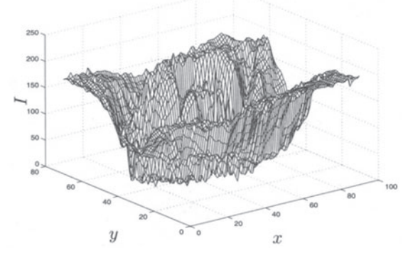
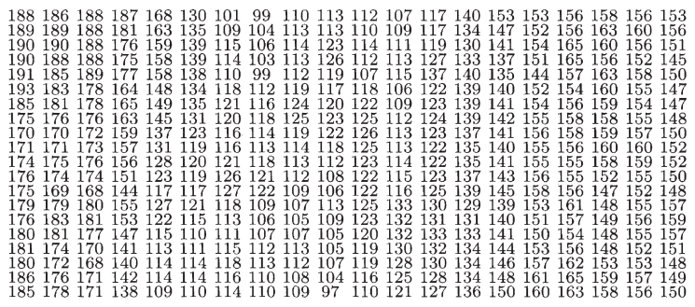
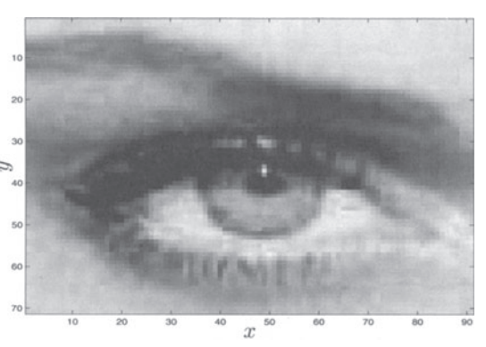
Frontend
Frontend works directly with the sensors
Converts measurements into geometric entities that help solve SLAM
An image is a measurement of intensities how to convert to geometry???
Feature Extraction
&
Feature Matching

Slide 29
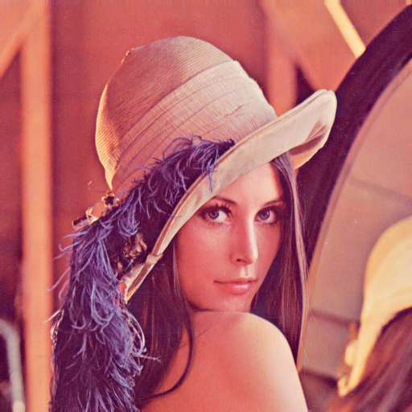
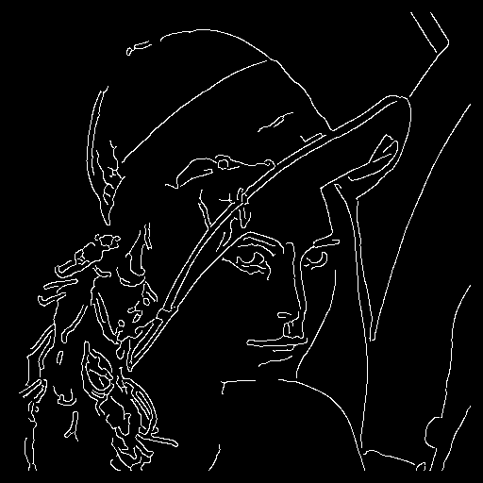
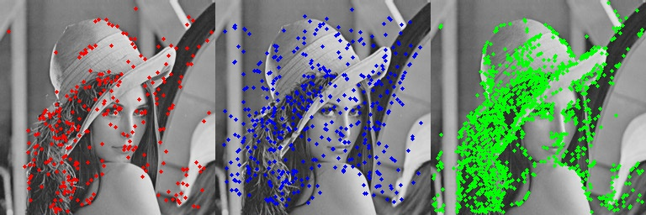
Frontend – Feature Extraction
Feature
Easy to identify
Scale invariant
Rotation invariant
Harris corner, FAST, SURF

Slide 30
Frontend – Feature Extraction
Feature
Easy to identify
Scale invariant
Rotation invariant
Harris corner, SIFT, SURF, ORB, FAST, HOG…

Slide 31
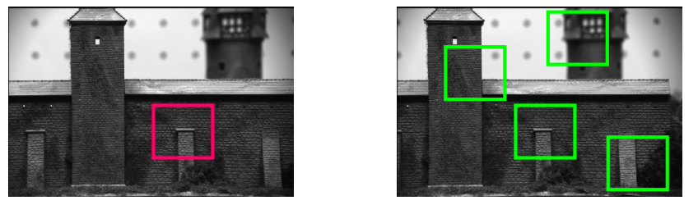

Frontend – Feature Matching
Descriptor based matching
Encodes neighborhood information
Eg: BRIEF Descriptor
Matching metrics
SSD – Sum of squared difference
Cross correlation

Slide 32
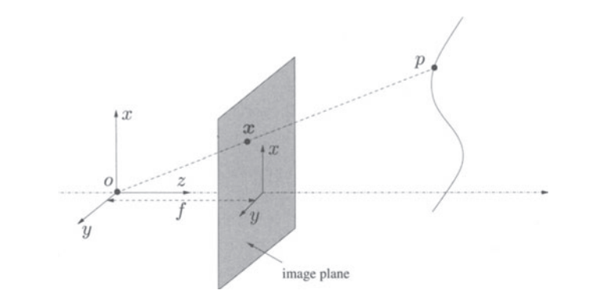
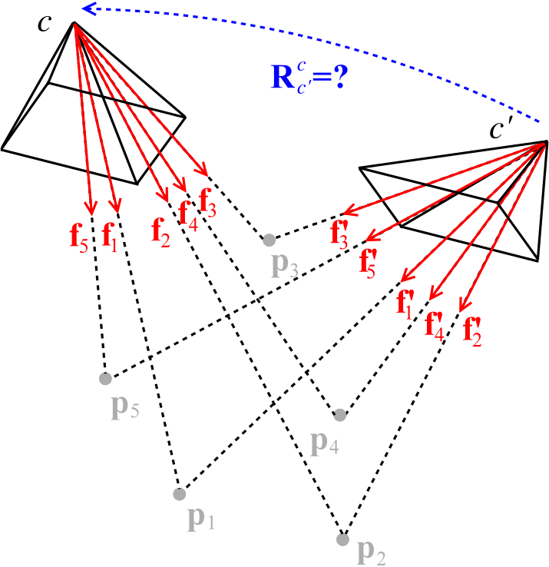
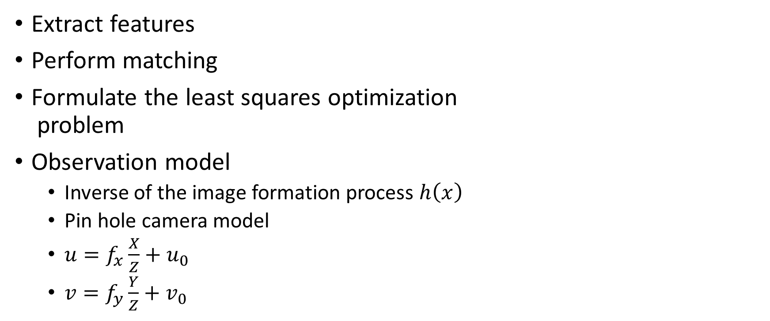
Frontend – Visual Odometry
Extract features
Perform matching
Formulate the least squares optimization problem
Observation model
Inverse of the image formation process $h\left(x\right)$
Pin hole camera model
$u=f_{x}\frac{X}{Z}+u_{0}$
$v=f_{y}\frac{Y}{Z}+v_{0}$

Slide 33
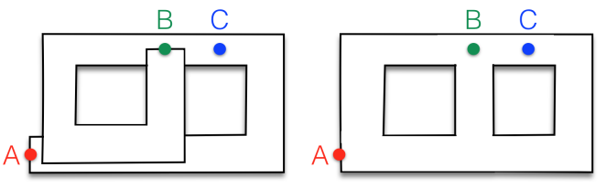
Backend
Performs global consistency
Sparsify the problem
Performs loop closure
Reduces drift
Prevents infinite corridor problem

Slide 34
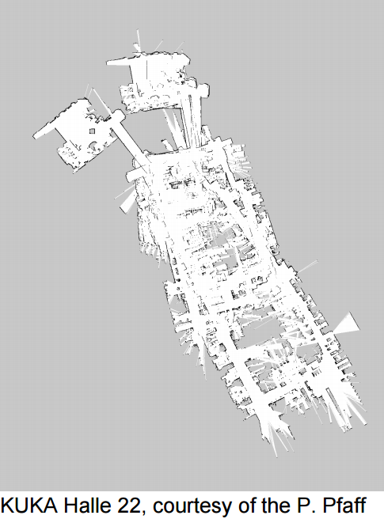
Backend

Slide 35
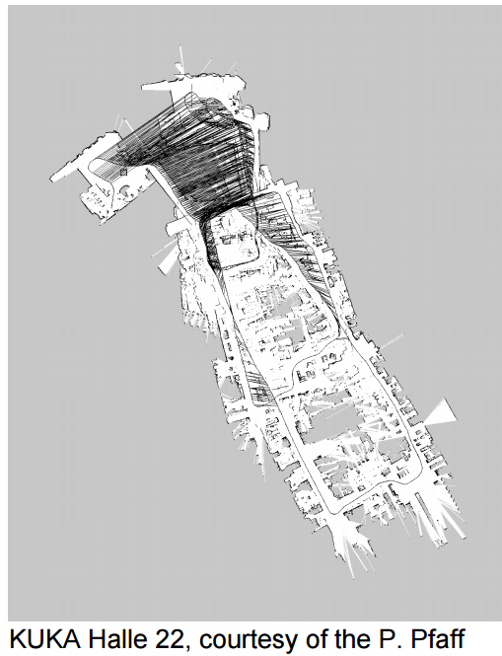
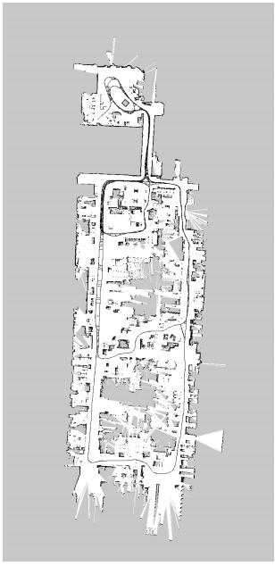
Backend -

Slide 36
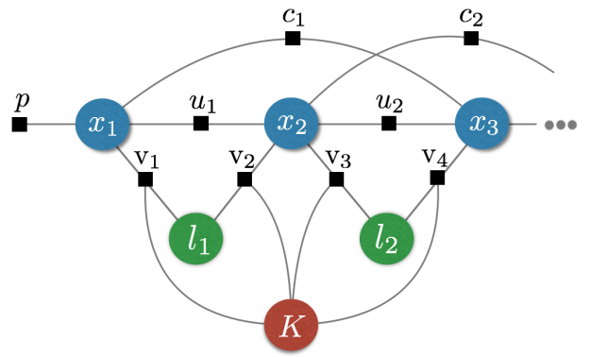
Backend – Factor graph Optimization
Factor graph representation
Vertices – states of the system
Edges – constraints between the states
Can encode the entire SLAM problem into a single optimization problem

Slide 37
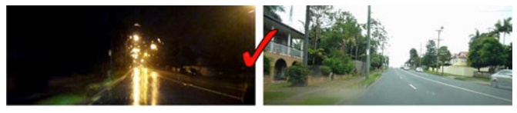
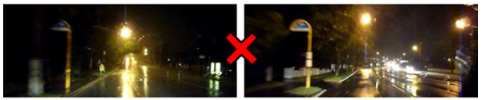
Backend – Loop Closure
Visual SLAM - Place recognition
Bag of Words technique
Learn a dictionary of common appearance
Use it to describe images

Slide 38

GraphSLAM
SLAM can be interpreted as a sparse graph of nodes and constraints between nodes.
nodes: robot locations and map-feature locations
edges: constraints between
consecutive robot poses
robot poses and the features observed from these poses.

Slide 39
GraphSLAM
Key property: constraints are not to be thought as rigid constraints but as soft constraints
Constraints act like springs
Solve full SLAM by relaxing these constraints
get the best estimate of the robot path and the environment map by computing the state of minimal energy of this spring mass network

Slide 40

GraphSLAM

Slide 41
GraphSLAM

Slide 42
GraphSLAM

Slide 43









GraphSLAM - Example
$$m_{0}$$
 | $$x_{0}$$ | $$x_{1}$$ | $$x_{2}$$ | $$m_{0}$$
$$x_{0}$$
$$x_{1}$$
$$x_{2}$$
$$m_{0}$$
9
-4
1
-1
+1
-5
5
$$x_{2}$$
0
$$x_{1}$$
+1
+1
-1
5
+4
$$x_{0}$$
$$x_{0}=0$$
$$x_{0} −x_{1}=−5 \\ −x_{0}+x_{1}=5$$
$$x_{1}−m_{0}=−9 \\ −x_{1}+m_{0}=9$$
$$x_{1}−x_{2}=4 \\ {−x}_{1}+x_{2}=−4$$
-1
1
-1
-9
-1
1
-4
-1
1
9
$$Ω$$
$$ξ$$
$$μ=Ω^{−1}ξ$$

Slide 44
GraphSLAM
The update time of the graph is constant.
The required memory is linear in the number of features.
Final graph optimization can become computationally costly if the robot path is long.

Slide 45
References Materials
“Probabilistic Robotics” – Sebastian Thrun, Wolfram Burgard, Dieter Fox
“An Invitation to 3D Vision” – Yi Ma, Stefano Soatto, Jana Kosecka, S. Shankar Sastry
“State Estimation for Robotics” – Timothy D. Barfoot
“The GraphSLAM Algorithm with Applications to Large-Scale Mapping of Urban Structures” – Sebastian Thurn, Michael Montemerlo
“Simultaneous Localisation and Mapping (SLAM): Part I The Essential Algorithms and Part II State of the Art”, Tim Bailey and Hugh Durrant-Whyte

